Slide 1
FDA Adverse Reactions Analysis – Group C
Group Members
Robert Voss
Erica Davis
Sohini Ponnam

Slide 2
Motivation & Summary
Objective of our project is to conduct analysis and develop visualizations related to the Adverse Events based on complaints submitted to FDA for foods, dietary supplements and cosmetics since 2004
We were interested in understanding the frequency of adverse food reactions across age, gender and timing of the year. Additionally, we wanted to understand the product types that led to reactions so we can educate ourselves and spread awareness of risk involved in using the products within our families and community. We were curious to see if the dire outcome i.e death due to food reactions was more likely in a specific age group
Our analysis of the data led to the following insights. Food reactions in the 41-60 age group is highest. The Female population is more prone reactions to food /cosmetics than the male population. Summer months have the highest occurrences of food reactions compared to the rest of the year. 2017 had the highest reported cases of food & cosmetics reactions

Slide 3
Questions & Data Details
Some of our questions based on internal team discussion are listed below
What product type had the most adverse reactions
Do adverse reactions occur more during a certain time of year?
Have adverse reactions increased or decreased over the last 10 years?
Do males or females report more adverse reactions?
Which age group reports the most adverse reactions?
How many outcomes and reactions were reported by each person?
We analyzed the information on the FDA API site listed below. The API contained information on Products, Consumers ,Reactions & Outcomes.
https://open.fda.gov/apis/food/event/understanding-the-api-results/

Slide 4
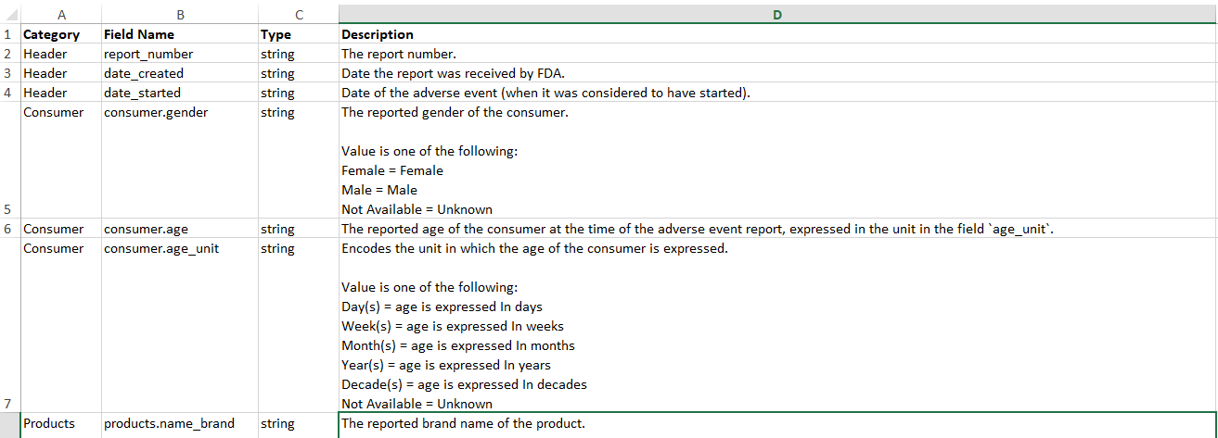
Data Exploration
Reviewed the Searchable fields on the website
https://open.fda.gov/apis/food/event/searchable-fields/

Slide 5
Data Exploration
An openFDA API query always begins with the base endpoint, which in this case is: https://api.fda.gov/food/event.json
Searches have a special syntax: search=field:term
Unless otherwise specified, the API will return only one matching record for a search. You can specify the number of records to be returned by using the limit parameter. The maximum limit allowed is 99 for any single API call. If no limit is set, the API will return one matching record
Our initial exploration of data was based on sample data set on the Food API website. The JSON file we reviewed represented the results list with sub-sets of reactions, products, consumer & outcome information.

Slide 6
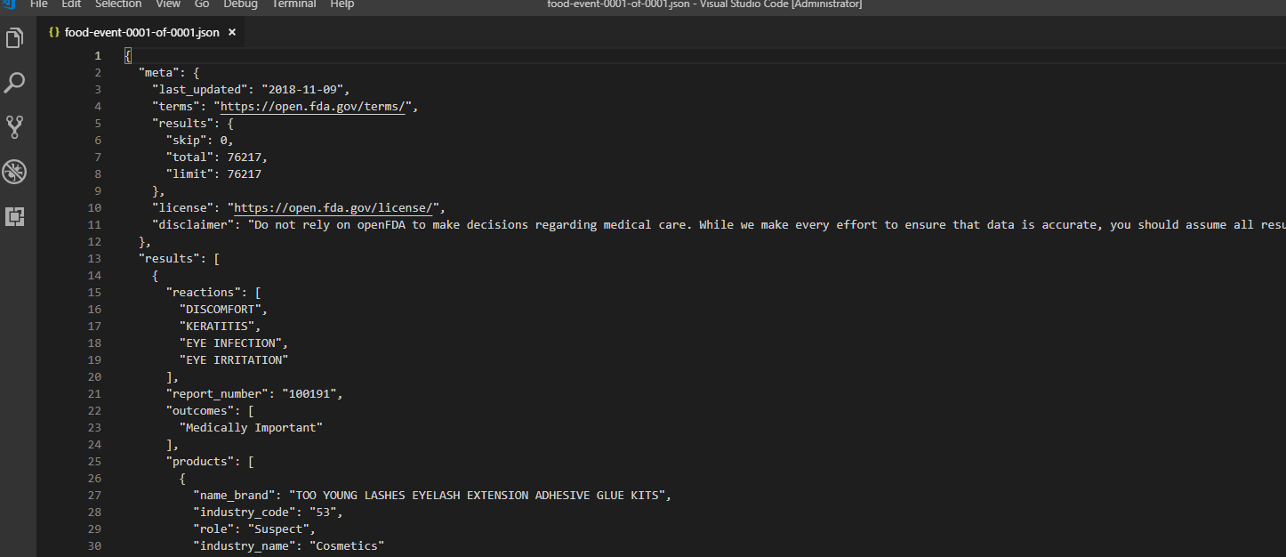
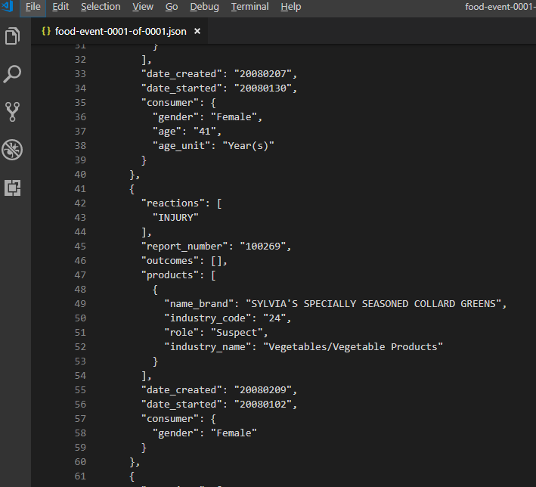
Data Cleanup & Exploration – JSON File

Slide 7
Data Cleanup
The final output contained a list of values within the columns in the dataframe for reactions & outcomes .We determined the need to have a count of the lists (outcomes and reactions) since count was going to be a key data element in determining some of the answers to our initial questions
During the API call we introduced a single loop that was supposed to call the API for each date on the list. This call resulted in a considerable low record count over the years of data on the FDA database. In order to fix the issue, we analyzed the API results and introduced a secondary loop to call the API for 100 distinct records for each date.

Slide 8
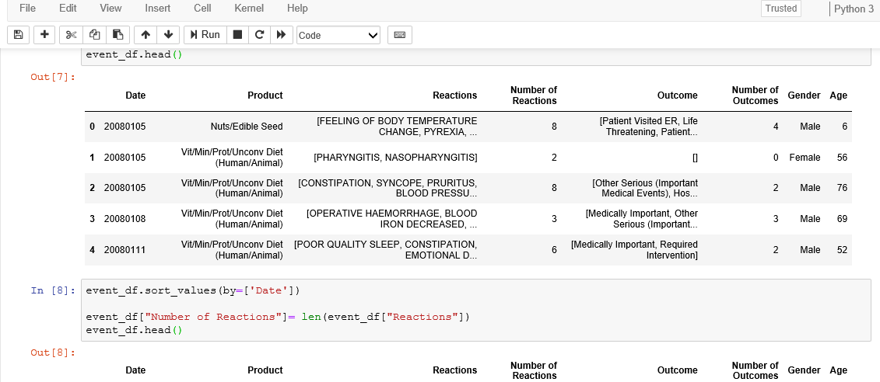
Data Cleanup – Initial Results in DataFrame

Slide 9
Issues Encountered and Resolution
For the question related to outcomes and reactions (What is the most common outcome of adverse reactions) we ran into issues with the design related to the Panda DF. The outcomes and reactions were lists within separate columns and a common characteristic that we were able to identify for plotting was missing
After numerous attempts we could not resolve the issue by converting the lists to individual columns and used 2 Y axes with outcomes and reactions and X axis was years

Slide 10
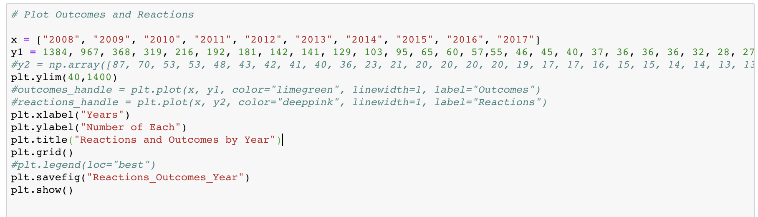
Issue with Plotting 2 Y-Axes

Slide 11
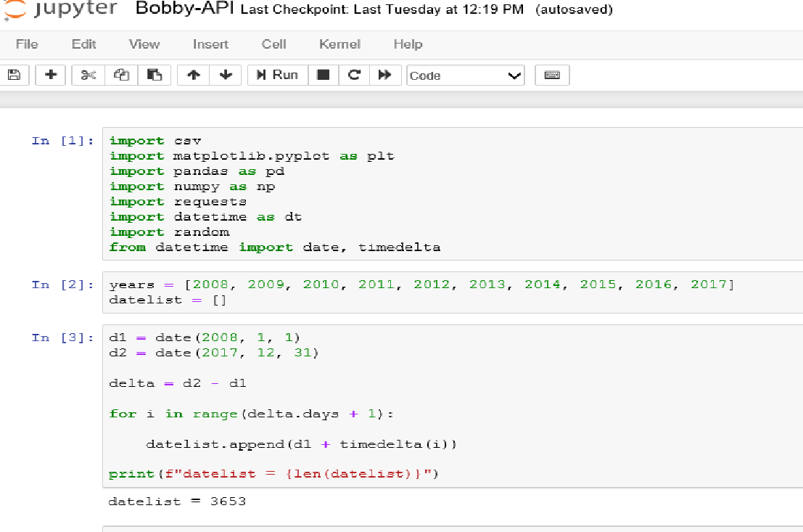
API Date Issue

Slide 12
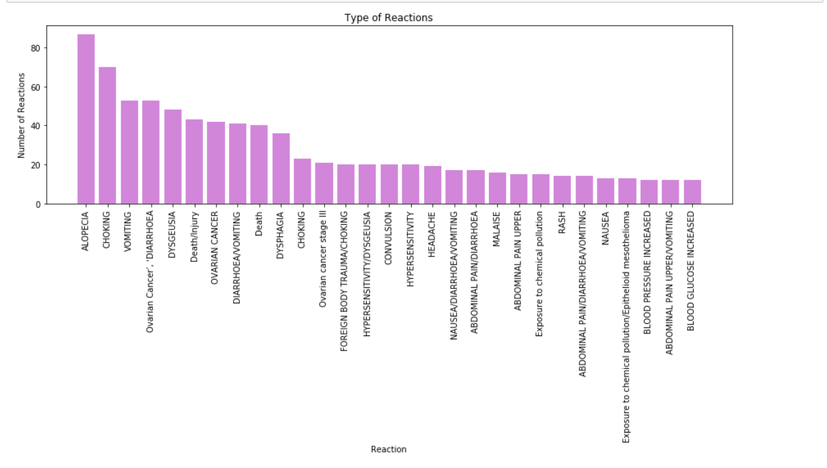
What are the most common reactions?

Slide 13
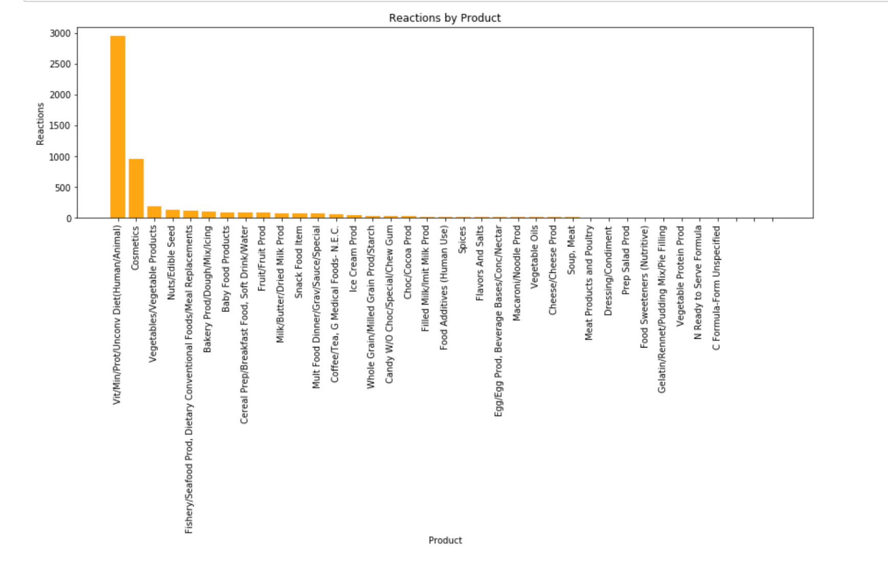
What product type had the most adverse reactions?

Slide 14
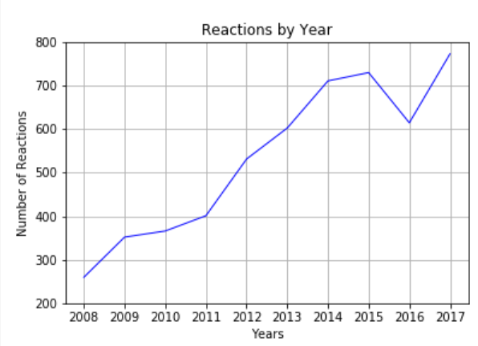
Have adverse reactions increased or decreased over the last 10 years?

Slide 15
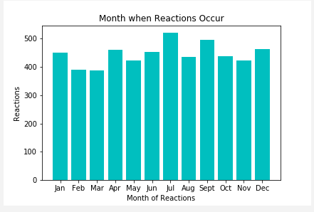
Do adverse reactions occur more during a certain time of year?

Slide 16
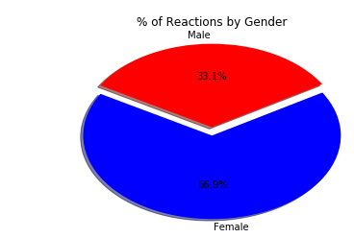
Do males or females report more adverse reactions?

Slide 17
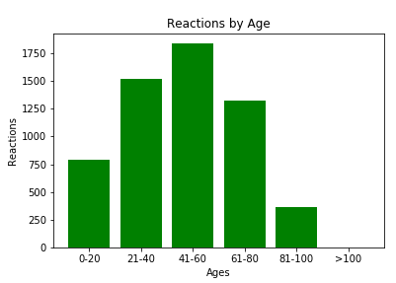
Which age group reports the most adverse reactions?

Slide 18
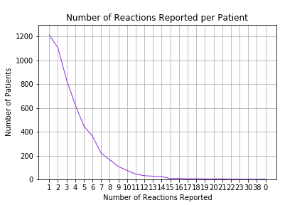
How many reactions were reported by each person?

Slide 19
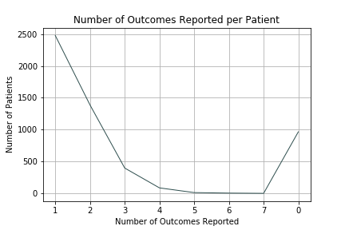
How many outcomes were reported by each person?

Slide 20
Findings & Conclusion
We were surprised to see that the distribution of reactions across age groups was uniform. We anticipated young or old to being more prone to food borne illnesses and reactions
Female population is more prone to food & cosmetic reactions than male population. Some of the reactions can result in serious medical conditions and death. Please check the FDA website for warnings on Food Safety

Slide 21
Post Mortem
We ran into issues with pseudo-code and syntax when we tried to apply binning to consumer age column and we resolved the same with help from Jon, TAs and trial and error
We would like to combine the complaints information from FDA and identify if the product from the list were recalled correctly. We can potentially accomplish that by using the API related to recalls and if we do not find a match create a list of products in order to raise awareness

Slide 22
Questions
??

